Slide 1


SWARNANDHRA
College of Engineering and Technology
(Autonomous)
Permanent Affiliated to JNTUK, Kakinada, Approved by AICTE
Narsapur, Andhra Pradesh 534280,India
Department Of Artificial intelligence and Machine Learning
Project Title:Design and implementation of sales trends through predictive modeling using simple linear regression
Team No:14
Review No:3
Y.Gopi vishal –22A21A5451
B.Anupama – 22A21A5409
B.Bhavani – 22A21A5406
Project Guide: G.Lakshminarayana

Slide 2
Problem statement
Accurate sales trend prediction is a critical challenge for businesses in dynamic and competitive markets.
Most existing prediction systems rely only on historical numerical data and do not consider human behavior factors such as customer preferences, seasonal trends, and market demand variations.
Therefore, there is a need to develop an intelligent system that integrates Simple Linear Regression with human behavior adjustments and an interactive interface to provide more accurate, reliable, and user-friendly sales trend predictions.

Slide 3
Objectives
To design a user-friendly interface for sales prediction.
To integrate human behavior into the prediction model.
To implement Simple Linear Regression.
To provide visual outputs for better understanding.

Slide 4
Existing system & limitations
Sales analysis is mostly done using historical data and basic statistical methods.
Traditional systems use spreadsheets or simple tools for prediction.
Predictions are based only on past sales trends without advanced modeling.
Limited or no use of machine learning techniques.
Many systems do not provide a proper user interface for easy interaction.
Limitations
Does not consider human behavior factors like demand changes, seasonality, and customer preferences.
Produces less accurate predictions.
Lack of real-time analysis and adaptability.

Slide 5
Proposed system
The proposed system uses Simple Linear Regression to predict future sales trends.
It integrates human behavior factors such as demand variation, seasonality, and customer preferences.
A user-friendly interface is designed for easy data input and result visualization.
The system performs data preprocessing, model training, and prediction automatically.
Advantages of Proposed System
Improves prediction accuracy by including behavior factors.
Provides an interactive and easy-to-use interface.
Reduces manual effort and human errors.
Helps in better business decision-making and planning.

Slide 6
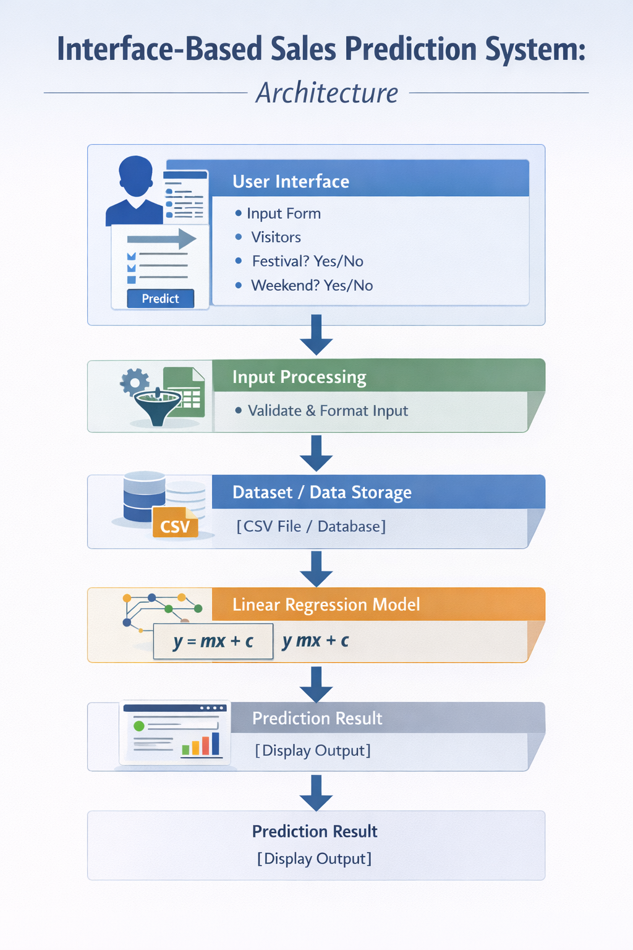
System architecture

Slide 7
Technology Stack
Python
Libraries: Pandas, NumPy, Matplotlib, Scikit-learn
Interface: Flask
Dataset: CSV / Excel

Slide 8
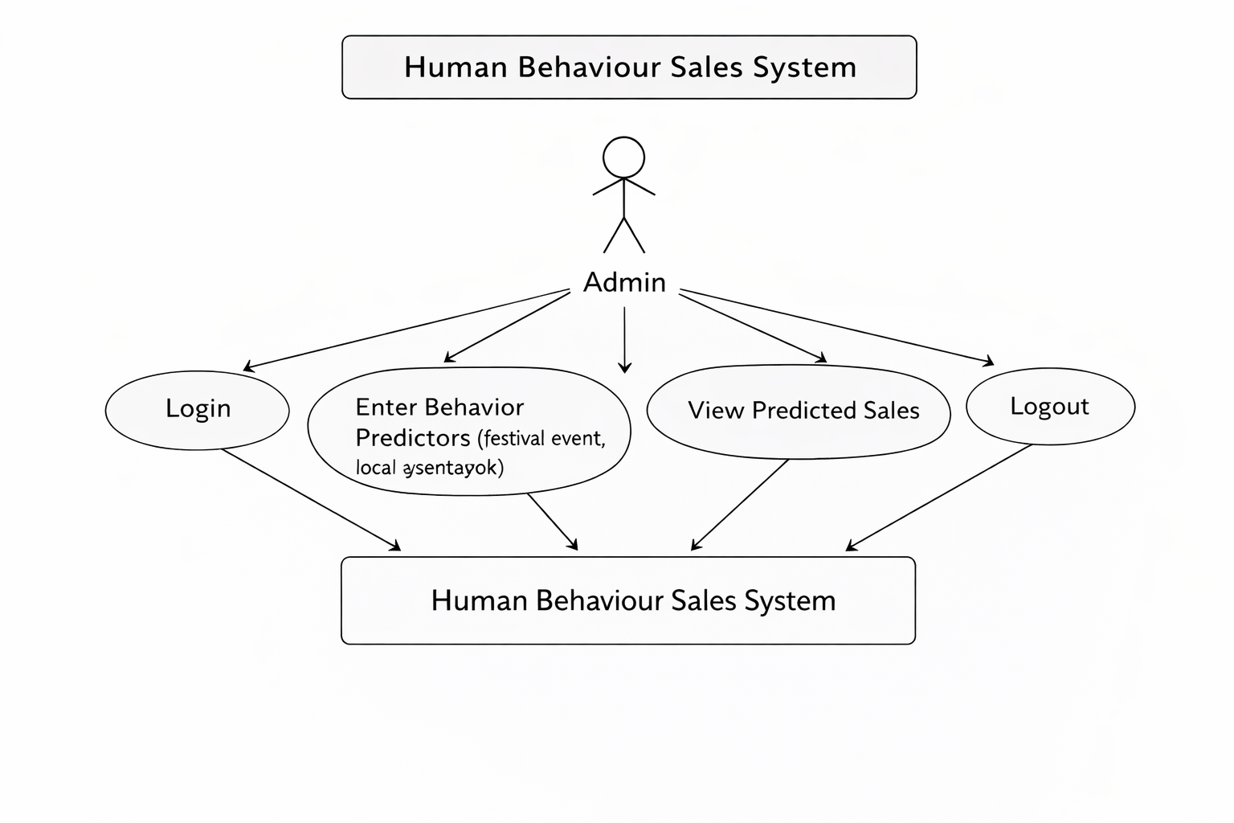
Use case diagram

Slide 9
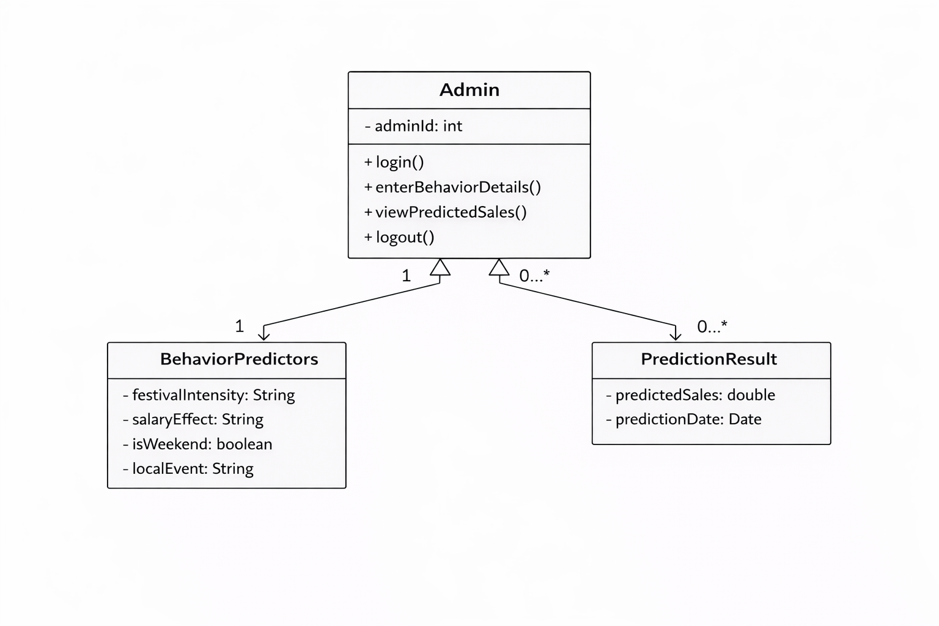
Class diagram

Slide 10
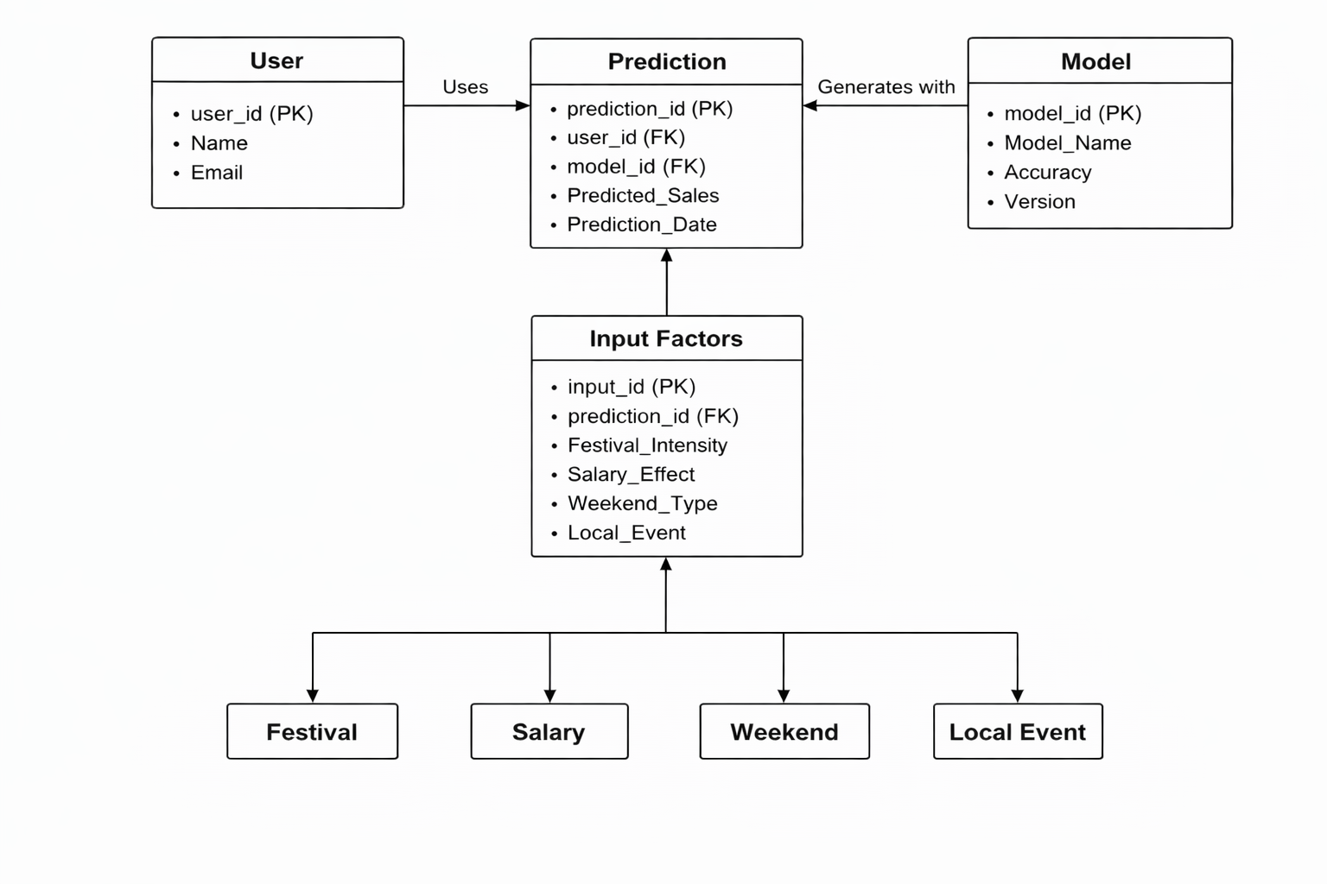
ER diagram

Slide 11
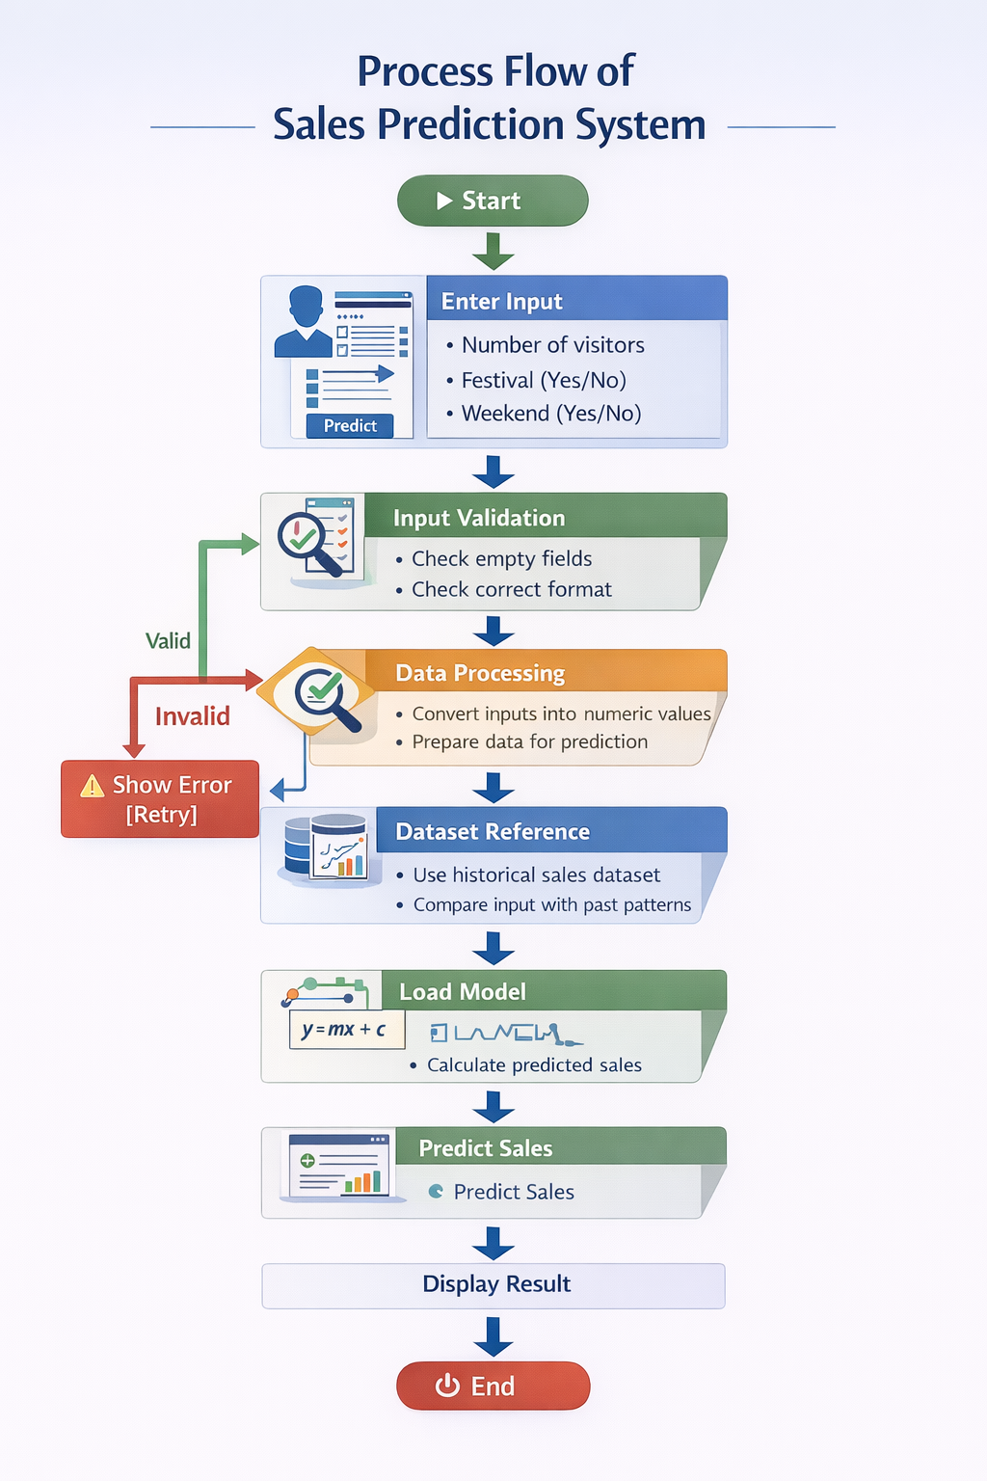
System Workflow

Slide 12
Dataset description
The dataset is designed for the project “Human Behaviour Adjusted Sales Trends Model.”
It contains sales-related data along with human behavioral factors that influence purchasing patterns.
The dataset is used to analyze and predict future sales trends.
Festival_Intensity – Level of festival impact (No Festival / Low / Medium / High)
Salary_Effect – Customer purchasing power (Low / Medium / High)
Weekend_Type – Weekday or Weekend
Local_Event – Indicates presence of events (Yes / No)

Slide 13
Methodology / Model Used
Data Collection
  Gather sales data and human behaviour factors
Data Preprocessing
  Clean data and convert categorical values
Feature Selection
  Select key inputs (festival, salary, weekend, events)
Model Training
  Use Linear Regression to learn patterns
Prediction
  Generate predicted sales based on user inputs
Interface
  Display output using web interface (Flask)

Slide 14
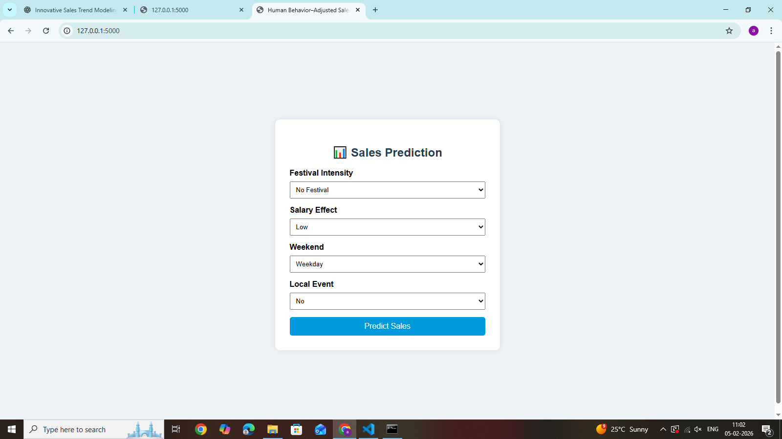

Slide 15
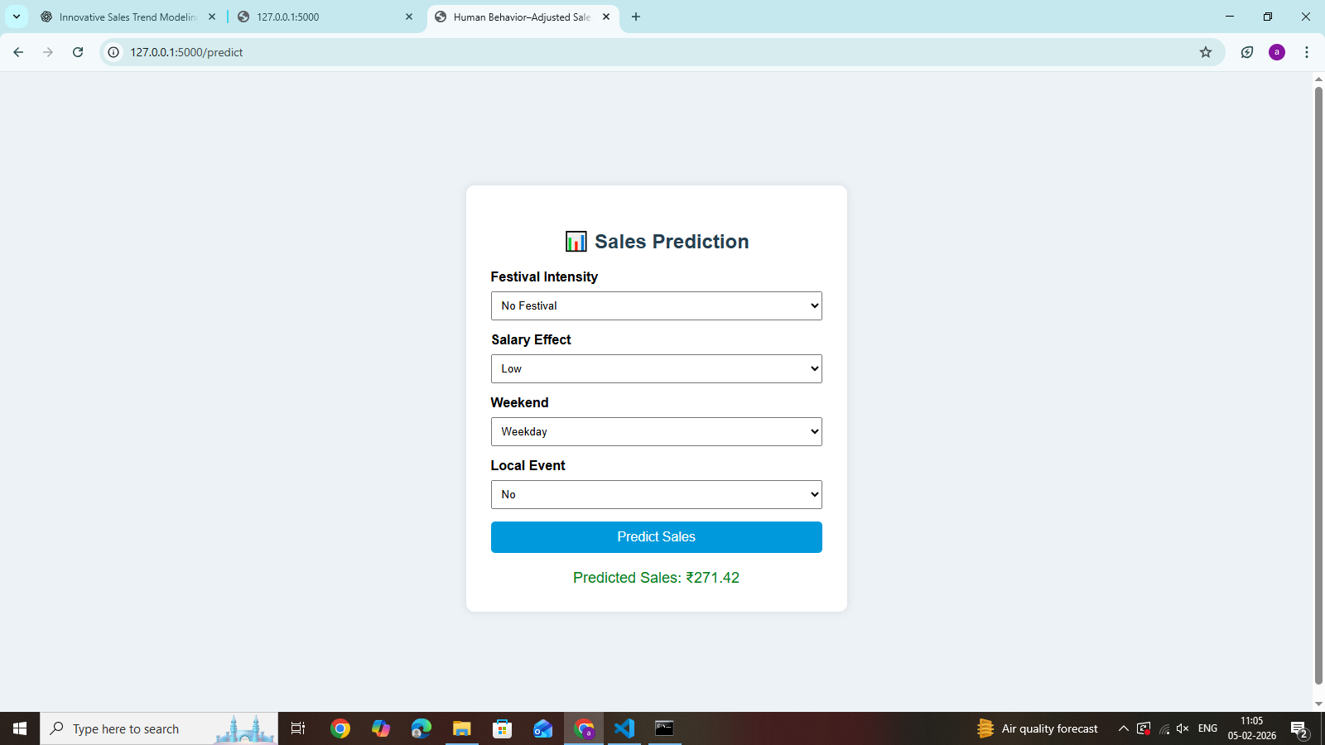

Slide 16
Output Results
The system takes sales data and human behavior inputs from the user. It processes the data and generates adjusted sales results based on factors like festival,weekend,local event,salary.
The output shows both original and modified sales values, helping users understand the impact of human behavior on sales.
It also gives simple suggestions for better decision-making. The system provides results quickly and is easy to use.

Slide 17
Performance Analysis / Evaluation
Model performance is evaluated using MAE, MSE, RMSE, and R² Score
Comparison between Basic Regression and Behavior-Adjusted Model
Behavior-based model shows lower error and higher accuracy
Provides better prediction during seasonal and demand changes
System is efficient, fast, and reliable

Slide 18
Future Enhancements
Implement advanced models like Multiple Linear Regression and Machine Learning algorithms
Integrate real-time data for more accurate predictions
Add more human behavior factors (social trends, customer feedback)
Develop a web/mobile-based user interface
Improve data visualization dashboards
Apply AI techniques for better forecasting accuracy

Slide 19
conclusion
The proposed system successfully predicts sales trends using Simple Linear Regression by analyzing historical data. By incorporating human behavior factors such as seasonal demand and customer preferences, the accuracy of the predictions is significantly improved. The system provides a clear understanding of sales patterns and helps in forecasting future demand effectively. It is simple, efficient, and easy to implement, making it suitable for real-world business applications. Overall, the project supports better decision-making and planning by delivering reliable sales insights.

Slide 20
References
Ackerman, M.S., L.F. Cranor, and J. Reagle. (1999). “Privacy in E-Commerce: Examining User Scenarios and Privacy Preferences.” In Proceedings of the ACM on E-Commerce, Denver, Colorado.
Annacker, D., S. Spiekermann, and M. Strobel. (2001). “E-privacy: Evaluating a New Search Cost in Online Environments.” In Proceedings of the 14th Bled Conference of Electronic Commerce, Blet, Slovenia.
Ariely, D. (2000). “Controlling the Information Flow: Effects on Consumers' Decision Making and Preferences.” Journal of Consumer Research, forthcoming, currently on: http://www.mit.edu/~ariely/.
Bauer, R.A. (1960). “Consumer Behavior as Risk Taking.” In R. Hancock (ed.), Dynamic Marketing for a Changing World, Chicago, 389–398.
Bäumler, H. (2000). E-Privacy - Datenschutz im Internet. Braunschweig/Wiesbaden.

